Slide 1
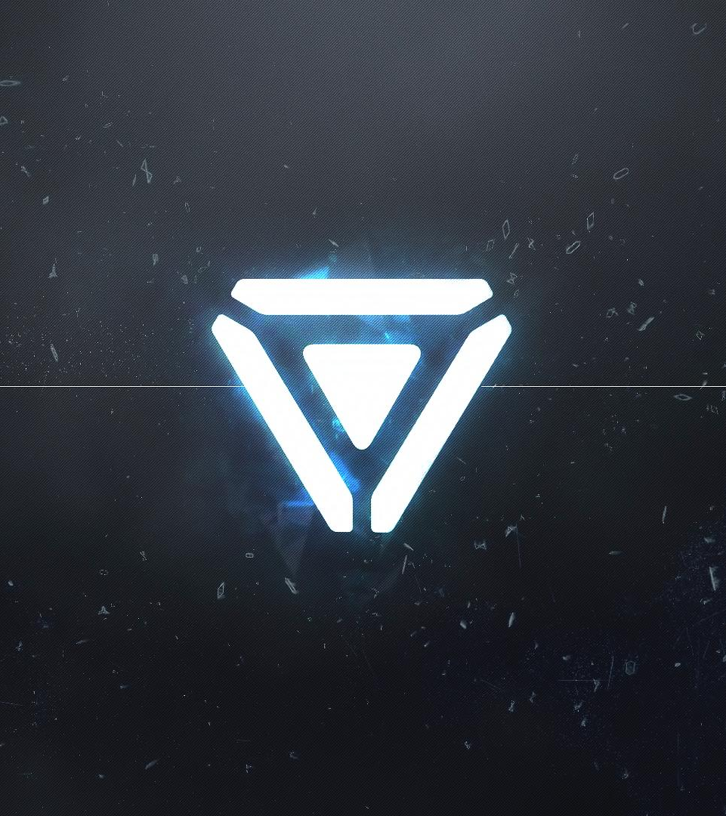
Project 48: Elementalist
Son Nguyen
GDD 201 – Project 2 Design Document
Prof. Bertozzi
11/11/2019

Slide 2

Game Overview

Slide 3
Game Concept / Genre / Target Audience
Platformer game
Target audience: 16+ and PC gamer
Game Concept :
The player needs to find his/her lost memories in a near future world where the machine creatures turned human into cyborgs for the war purposes

Slide 4


Game flow summary
Project 48 has many levels, and each level has a unique design and playstyle.
The player tries to pass a level by solving puzzles and fighting with machines in it.
The skill tree system is based on elements. The player may need to combine 4 basic elements to create a new element in order to solve a puzzle or fight enemies.
The player must pick up memory fragments to unlock the boss room, which also reveals the character’s story after defeating the boss.

Slide 5
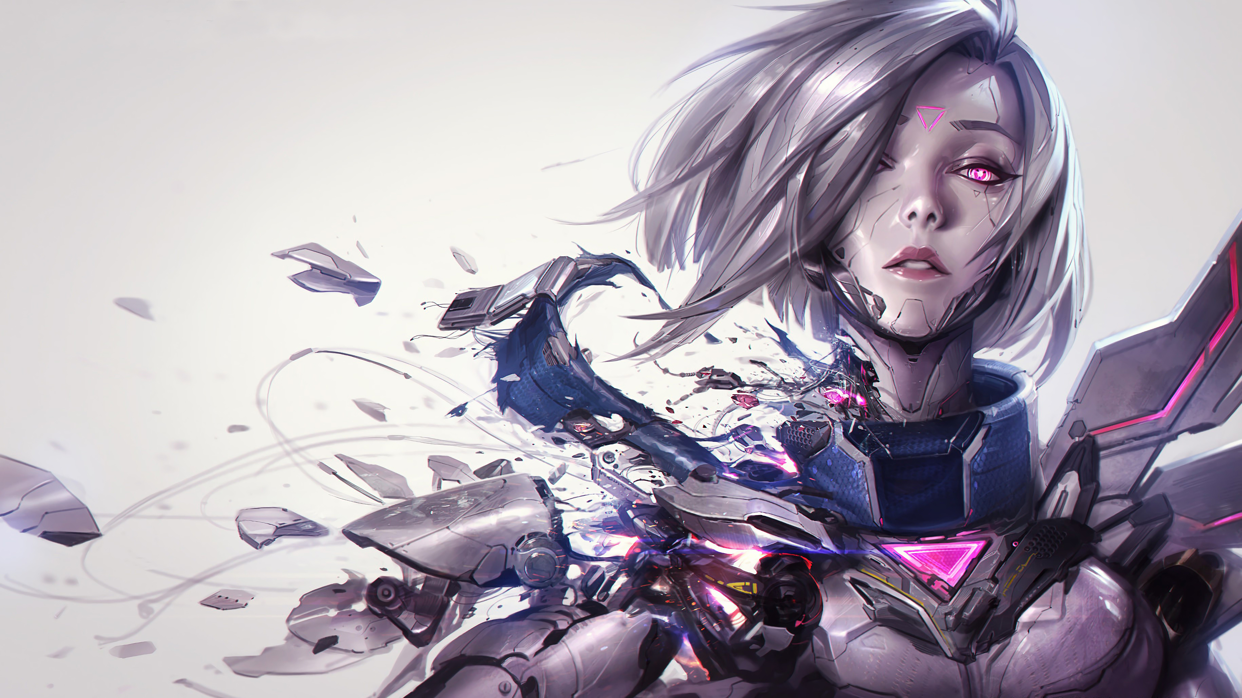

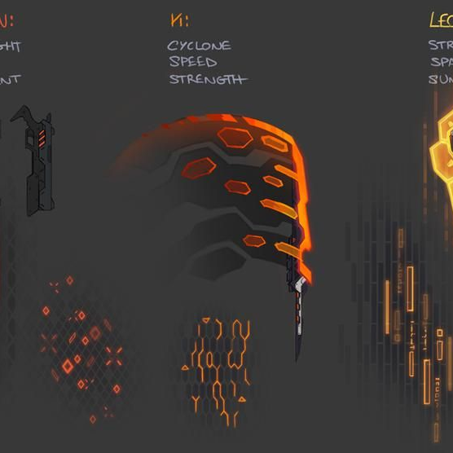
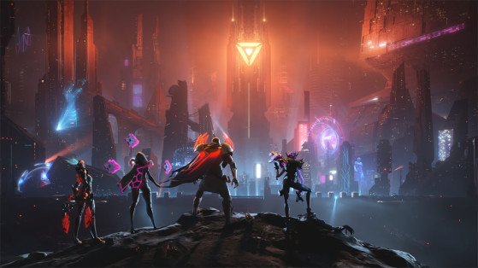
Look and Feel
Inspired by the Project skin in League of Legends.
Cyberpunk theme.
Focus on using neon color and high-tech city as the background.
Mysterious and fascinating feeling for the player by the futuristic game concept.
Using the Electronic Post-Rock as the main soundtrack.

Slide 6

Gameplay

Slide 7
Progression
The player starts as a weak unknown cyborg.
By completing the tutorial, the player will unlock the first skill – Launch.
By completing all missions in Chapter 1, the player will unlock the second skill – Element.
By completing all missions in Chapter 2, the player will unlock the third skill – Levitate.
Each completed mission will recover a part of the character’s memory.
In the end, the player receives a good or bad ending which is decided by the action of the player through the gameplay.

Slide 8
Mechanic
As a 2D Platformer game, the player can jump and move right, left, up, and down. In the late game, the player can double press the jump to levitate.
The player has a gun on the right hand which can deal a small amount of damage to the enemy and has infinite ammo (ammunition will be automatically refilled).
The player can upgrade his abilities by using the skill tree.
Using abilities costs the mana. The mana bar will be refilled overtime or 100% by using the mana pill.
There are three main abilities that the player can unlock through the gameplay:
Launch
Element Core
Levitate

Slide 9
Launch ( 5% Mana )
The player can pull any non-character/AI object in the game to his left hand by using the telekinesis power.
Release the Launch ability button to launch that object to the target.
Can be combined with jumping, levitating, and element cores.
Launch ability deals a moderate amount of damage to the enemy, which can be increased by combining with the element cores.

Slide 10

Element Cores
The player acquires this ability after defeating the Chapter 1 boss. When the player equips the element cores, the character can access to four basic elements: Fire, Water, Earth, and Air.
These element cores can’t be used as a weapon; however, they can be added to the weapon or the object that the player is holding.
It can combine with the Launch ability and guns.
For example: Fire Core + an object = Fire object (ignite an enemy or burn the ground).
In order to use the changing environment effect, the player must add at least one element to the object which is used for the Launch ability
By adding two or more cores on one object, that object has a new element and a new effect.
For example: Fire Core + Earth Core + an object = Lava object (instant kill an enemy or melt the ground).

Slide 11
Element Core Combination
STORM
LAVA
FIRE
AIR
EARTH
WATER
Note:
ICE
NATURE
Basic
Combination

Slide 12
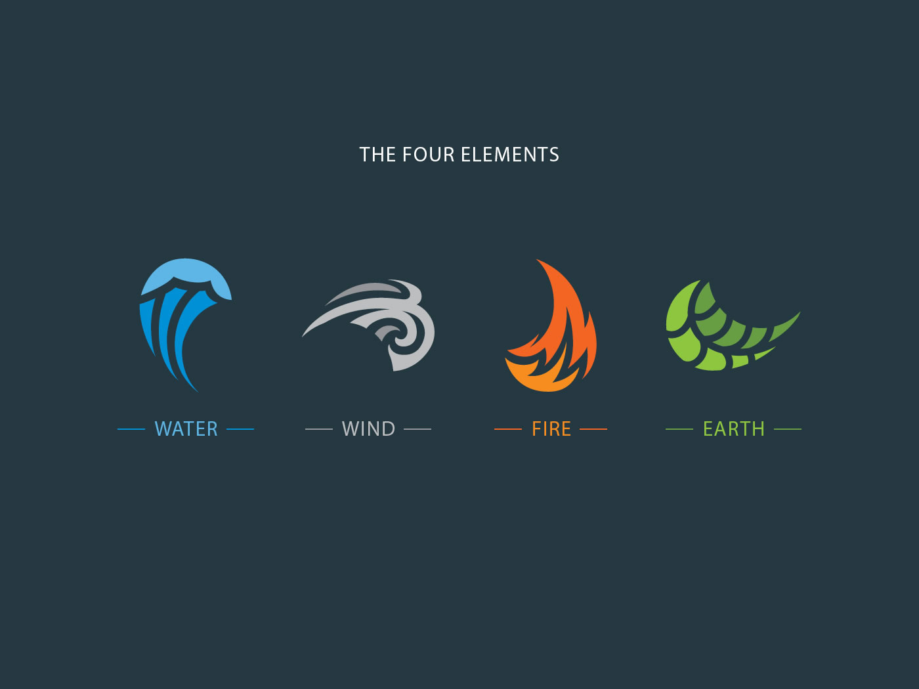
Element Core vs Enemies’ Element
The player must launch the counter element at the enemy to deal extra damage. Otherwise, Launch ability will only deal the basic damage.
Counter Chart:
Fire > Earth
Earth > Water
Water > Air
Air > Fire
Lava > Nature
Nature > Ice
Ice > Storm
Storm > Lava
Note: A > B means A counters B

Slide 13
Element Cores interacts with Enemies & Environment
Fire (10% Mana)
Environment: Create a burning area on the ground.
Enemies: Ignite an enemy.
Air (10% Mana)
Earth (10% Mana)
Environment: Create a pond on the ground , slow down everything on it.
Environment: Enhance the ground to make the player move faster on it.
Enemies: Pull enemies to the player.
Enemies: Slow enemies in a small area.
Environment: Create a platform.
Enemies: Stun enemies.
Water (10% Mana)

Slide 14
Element Cores interacts with Enemies & Environment
Lava (50% Mana)
Environment: Melt some parts of the platform.
Enemies: Instant kill an enemy if their HP < 40%
Storm (20% Mana)
Environment: Create a tornado which the player jump on it to launch himself into the air.
Enemies: Push enemies away from the player.
Nature (30% Mana)
Environment: Create trees which player can jump on it.
Enemies: Root enemies in a large area.
Ice (30% Mana)
Environment: Create a spiky trap on the ground.
Enemies: Stun the first enemy that the object hits.

Slide 15
Levitate ( No Mana cost )
The player can use the telekinesis power to push him away from the ground and levitate for a short amount of time
The player move freely in the air but with a slower speed.
The player can use other abilities in the air.
Falling from the levitate ability won’t give the player any damage.

Slide 16
Mission / Puzzle / Objective
Each level requires the player to solve puzzles kill all enemies in that level to proceed to the next one.
Puzzle example 1: The player needs to get over a hot lava surface without levitates. The solution is mixing the air and water core into a random object, then launch it onto the lava surface to cool down the lava, which creates a pathway for the player to pass.
Puzzle example 2: The player needs to get on a very high mountain. The player can combine water and earth core into a speck of dirt and launch it on the side of the mountain. The combination of earth and water will create a tree, which the player can jump on it and repeat that to climb the mountain.
The main mission is collecting the lost memory fragment as the story progresses. The player needs that fragment to complete the level. The lost memory fragment is usually hidden in chests, puzzles, or can be dropped after defeating a boss.

Slide 17
Play Flow
The player starts on the under left corner of the screen.
The player moves around to find the way and the lost memory fragment.
Monster spawns at specified locations.
After find the lost memory fragment, the UI will show the player the way to the Boss room.
After defeating the boss, the boss soul will repair the lost memory fragment and turn it into a memory card, which can be inserted into the player head to see the memory.

Slide 18
Physics / Movement
The player can move forward and backward, jump, and duck.
The player can interact with anything that he just created.
The object that the Launch ability uses can be affected by the gravity.
The player can open/break boxes or chest.
Storm, ice, and water objects can slow the player.
Lava and fire objects can burn the player.
Nature objects can heal the player.

Slide 19

Objects / Economy
Objects, items, and money in-game will drop after the player kill an enemy. The dropping rate of objects and items will be random when the dropping rate of soul energy will be 100% guarantee.
The Mana Pill refills the player’s mana 100%.
Soul energy will be used as the material of the skill tree.
In the skill tree, there are 5 levels for each ability:
Launch (+ damage ):
1000 SE / 2000 SE / 4000 SE / 8000 SE / 16000 SE
Element Core ( + effective ):
1000 SE / 2000 SE / 4000 SE / 8000 SE / 16000 SE
Levitate ( + duration ):
1000 SE / 2000 SE / 4000 SE / 8000 SE / 16000 SE
Each killed enemy drops 50 SE – 100 SE.

Slide 20
Screen Flow
Main Menu
Play / Continue
(Play the game)
Chapters
(Show completed levels)
Option
Graphic
Audio
HUD
Quit

Slide 21
Replaying / Saving
The player can respawn at the checkpoint after he’s dead.
There are at least 3 checkpoints for each level.
The progress of the game will be saved.

Slide 22
Game Option, Cheat, and Easter Eggs
The background of every boss is related to the main character’s story.
After defeating the boss, the player can choose to rescue the boss from the darkness or leave it.
Rescue all bosses : Happy Ending
Rescue at least 1 boss: Normal Ending
Don’t rescue any boss: Bad Ending

Slide 23

Story, Setting, and Character

Slide 24
Story and Narrative
In the near future, the government is overthrown by a machine army from the outer world. The machine army captures humans and turns them into cyborgs – half-machine half-human – for their purpose.
The player plays as a broken female cyborg which just had an intense battle with humanity. However, that cyborg is saved by an old woman. She brings the cyborg back and repairs her.
When the cyborg wakes up, it recognizes the woman’s house looks familiar. After talking to that woman, the cyborg knows that she is the woman’s grandchild, but she doesn’t accept it because she doesn’t have any memory about her.
She runs out of the woman’s house to find out the truth about herself. She decides to betray the machine army because she knows that they are the reason why she became like this. The cyborg takes Hanabi as her name.

Slide 25
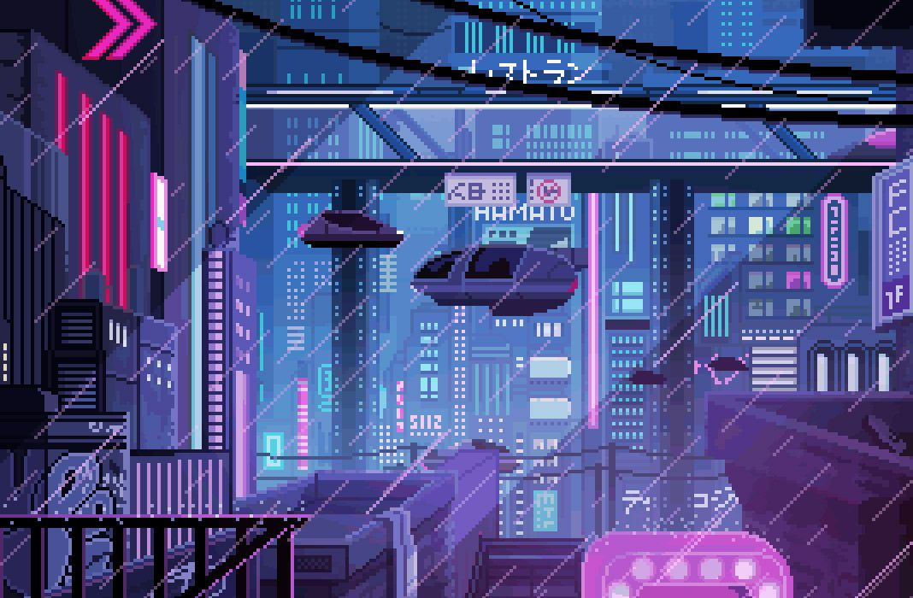
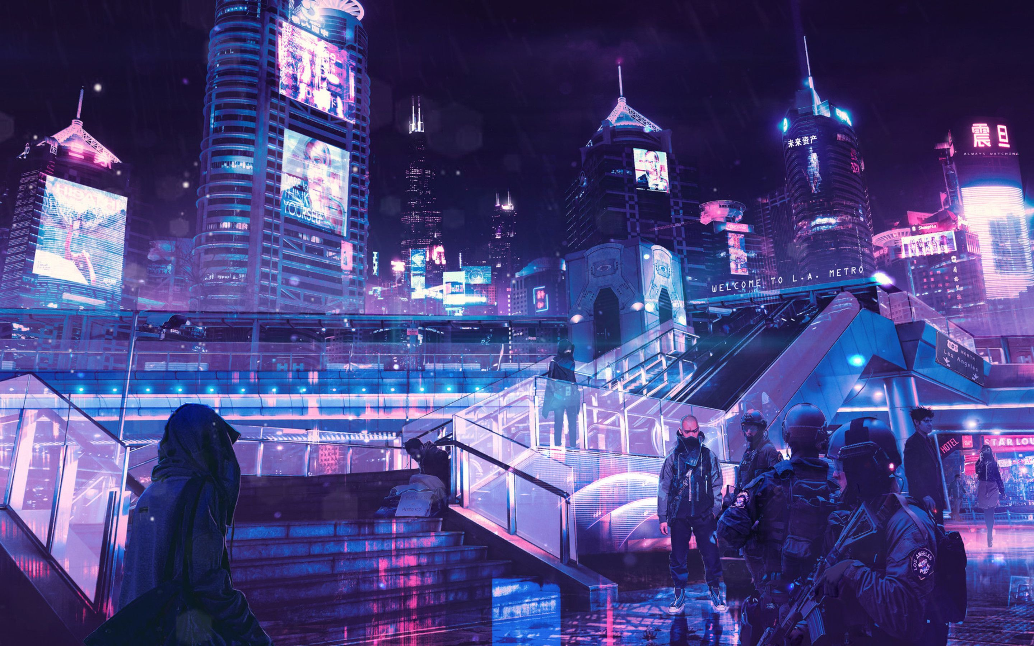
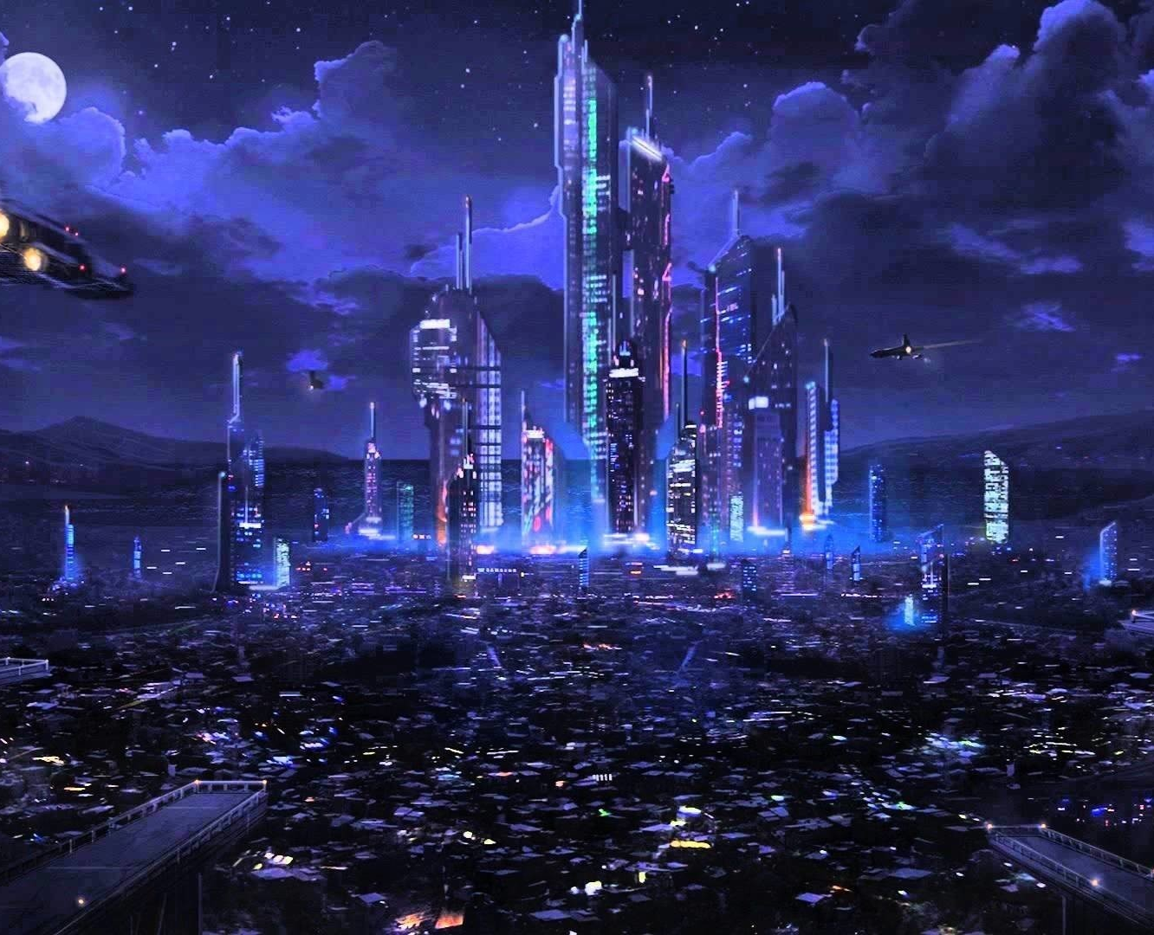
Game World
Project 48 uses the Cyberpunk style as the main theme of the game.
There are many areas in this game, from the big city to the outer world.

Slide 26

Character
Name: Hanabi
Codename (when in the machine army): Project 48
Female cyborg
Used to work for the machine army
Cold-hearted and quite personality.
Slogan: “ Life isn’t fair. Who can keep themselves alert is the strongest.”

Slide 27

Game Art, Level, Interface, and AI

Slide 28
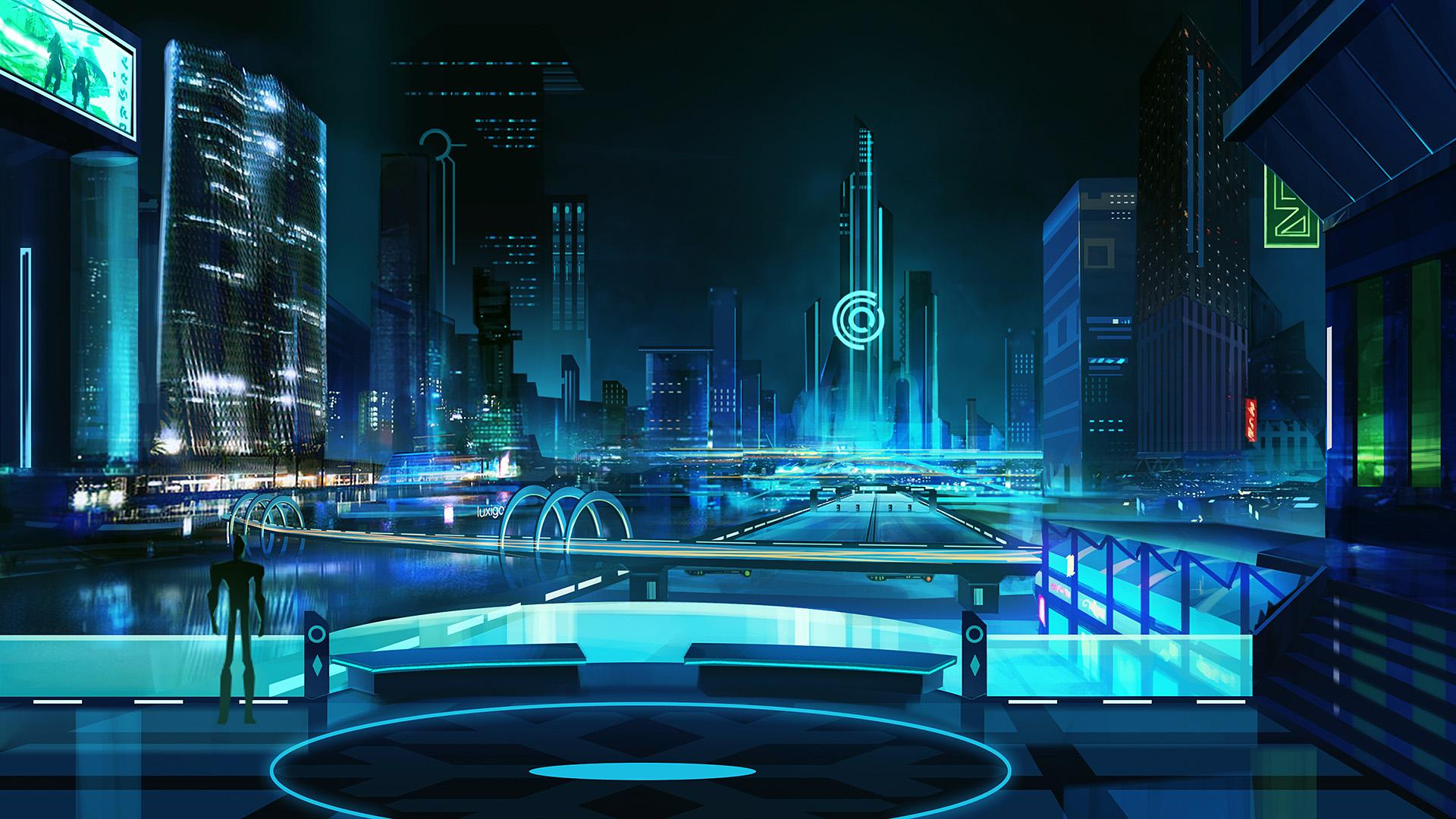
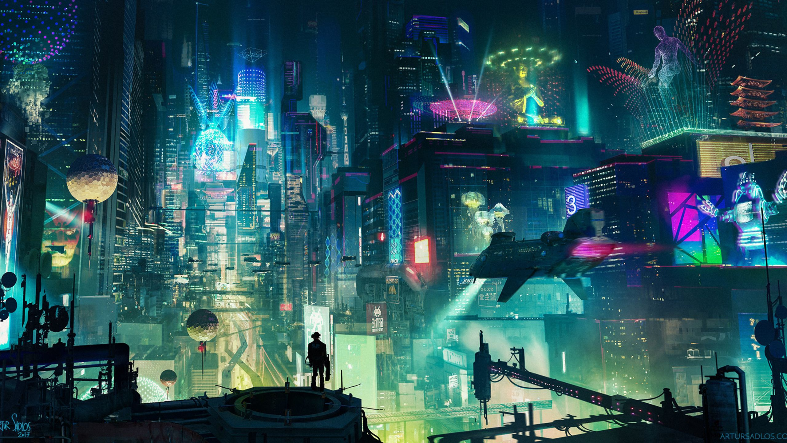
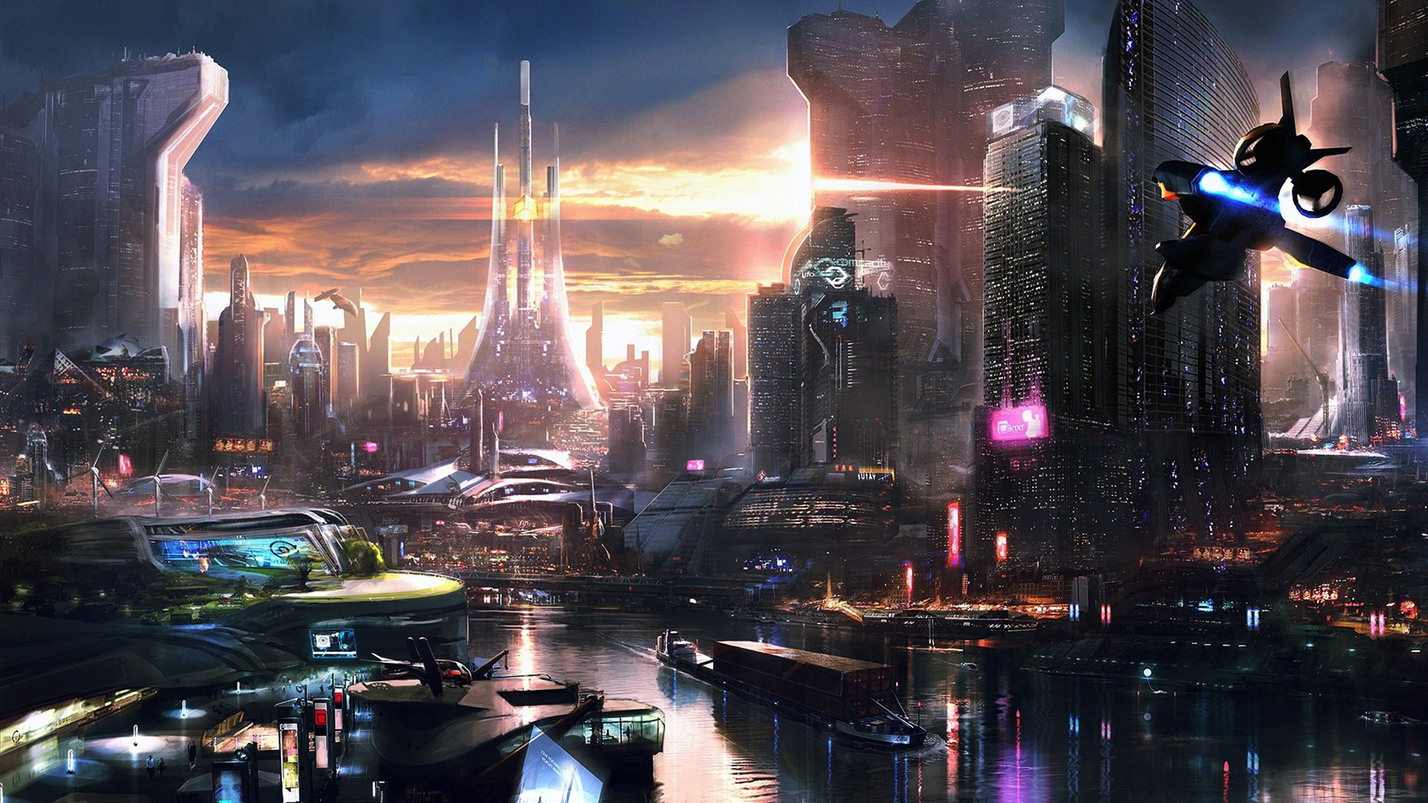
Game Art
Cyberpunk theme

Slide 29
Level
2D platformer
Levels will contain a lot of puzzles.
Using the cyberpunk theme with many skyscrapers in the background. The texture of the platform will use the cyberpunk art style too.

Slide 30
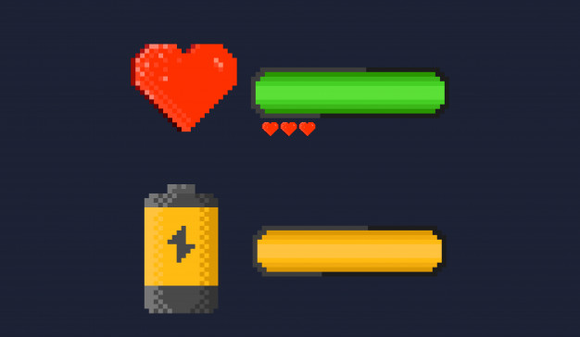
Interface
HUD will have an HP bar for health and a Mana bar for energy.
HUD also shows how much soul energy the player earns from killing enemies.
After picking up the lost memory fragment, the screen will have a guider arrow which shows the player where is the boss room.
HUD will also show the ability tab, and which weapon the player is using.

Slide 31
Control System
Use A & D to move backward and forward.
Use W to Jump, S to duck.
Use 1, 2, 3, 4 to use the Element Cores (The player can custom each slot)
Use mouse to aim, mouse 1 to shoot, mouse 2 to use Launch ability.
Use space or double click on W to levitate.

Slide 32
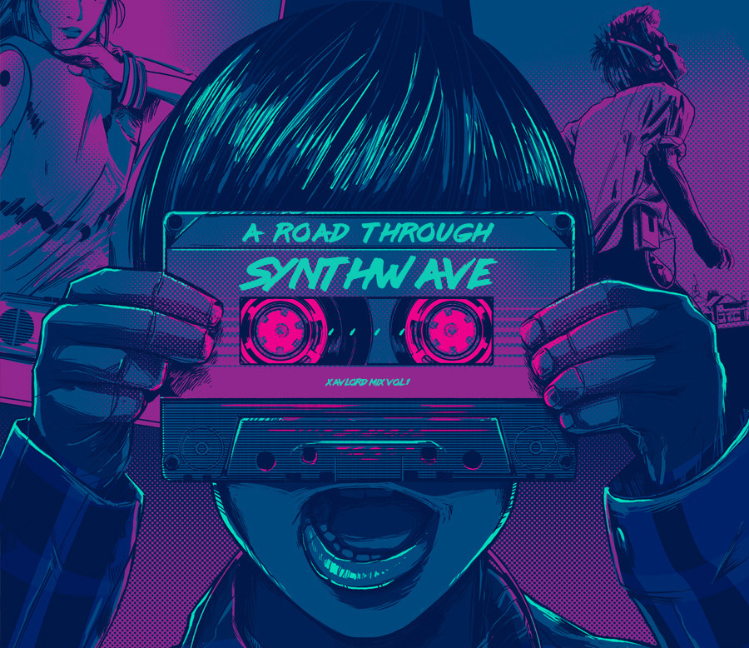
Audio System
Using the Cyberpunk theme music as the main soundtrack
Example: https://www.youtube.com/watch?v=Q9yn1DpZkHQ
Also using the high-tech music for boss fight.

Slide 33

Tutorial
There is a tutorial at the beginning of the game.
The player will learn how to move and shoot.
After finish the tutorial, the player will unlock the Launch ability.
There will be a detail explanation for the skill tree of the Element Cores and the combination guide among elements.

Slide 34

Artificial Intelligence
Enemy AI system will be different depending on the type of enemy it applies to:
For examples:
Normal creep: Low intelligence
Machine army captain: Moderate intelligence
Machine army general: High intelligence
The scale of AI intelligence defines how the AI fight with the player.
NPC AI system doesn’t do anything besides talking to the players.

Slide 35

Technical and Requirement

Slide 36

Target Hardware and Network Requirement
Target Hardware
Low-end PC or laptop
No requirement for GPU
Network Requirement
No requirement

Slide 37
Development Engine
Unity
WebGL
Adobe Photoshop
Aseprite

Slide 38

References

Slide 39
League of Legends
Cyberpunk 2077
https://www.google.com/search?q=cyber+punk+wallpaper&rlz=1C1CHBF_enUS791US791&sxsrf=ACYBGNSOD5OAas9ntLI1NDK65IKgV1Skkw:1573256028560&source=lnms&tbm=isch&sa=X&ved=0ahUKEwjPleS149vlAhUpmuAKHWP5AxcQ_AUIEigB&biw=1920&bih=888

